Slide 1
Fluctuations and Response in Non-reciprocal Biophysical Models
Kristian Angeli Pajanonot
Supervisors: Dr. Edgar Roldan
Dr. Sarah Loos

Slide 2
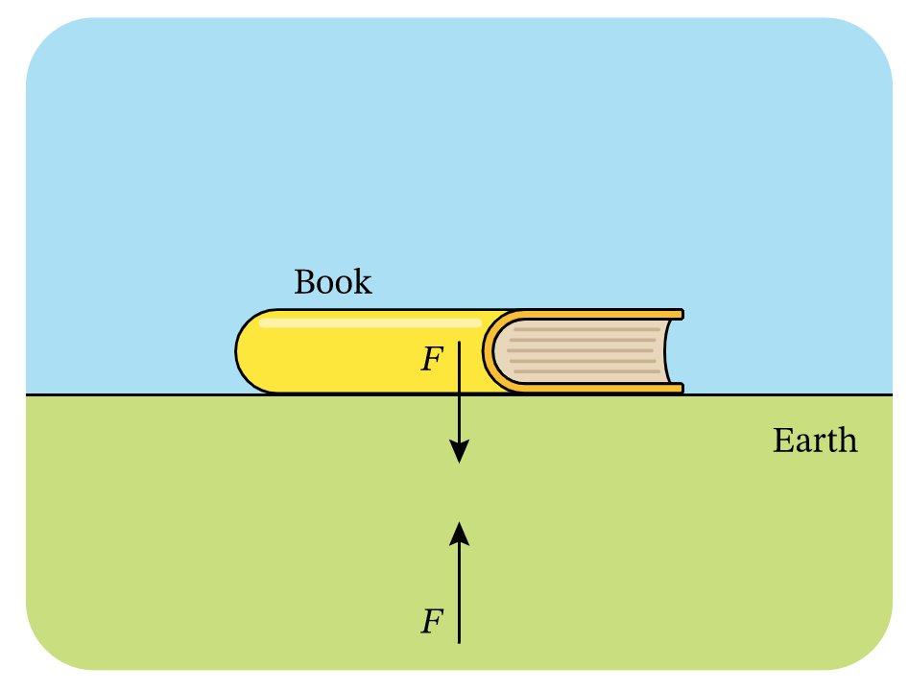



Non-reciprocal interactions
Introduction
Physical interactions between particles that are coupled are typically reciprocal
Reciprocal interaction
$$action =reaction$$
There is gravitational force on the book due to Earth and the gravitational force of the book on Earth (action = reaction)
book
$$F$$
Earth
$$F$$
Image from:

Slide 3

Non-reciprocal interactions
Introduction
However, reciprocal interactions are often broken in models of many complex living systems

Slide 4
Non-reciprocal interactions
Introduction
However, reciprocal interactions are often broken in models of many complex living systems

Slide 5

Non-reciprocal interactions
Introduction
However, reciprocal interactions are often broken in models of many complex living systems
Birds in flocks demonstrate how easy the law can be broken since they alter their flying patterns in reaction to the birds in front of them, but not vice versa.
Non-reciprocal interaction
$$action ≠reaction$$

Slide 6
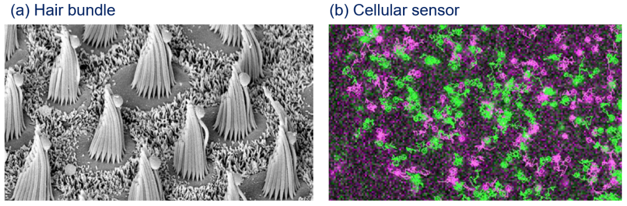
Non-reciprocal interactions in small-scale systems
Introduction
Image from: (a)
(b)

Slide 7
Non-reciprocal interactions in small-scale systems
Introduction
What are the thermodynamic implications of systems that exhibit non-reciprocal interactions?
Image from: (a)
(b)

Slide 8
Theory

Slide 9
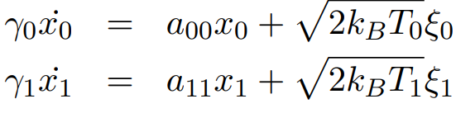
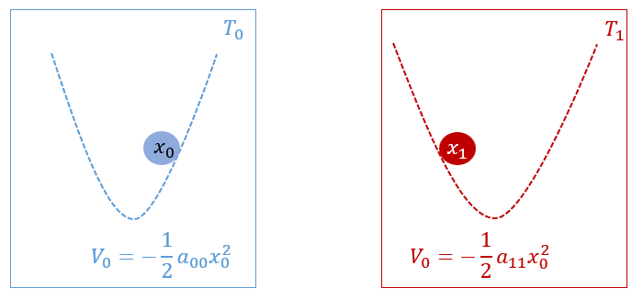
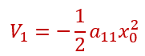
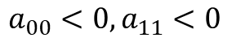
2-Dimensional Overdamped Langevin Equation
Theory
Case 1: Two uncoupled systems
(2)
$$a_{00}<0,a_{11}<0$$

Slide 10
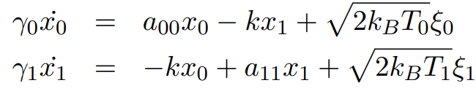
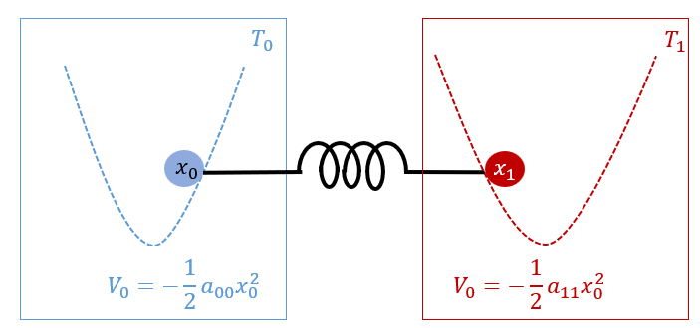
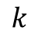
2-Dimensional Overdamped Langevin Equation
Theory
Case 2: Two systems coupled by a spring (coupling is reciprocal)
(3)
$$k$$
$$a_{00}<0,a_{11}<0$$

Slide 11
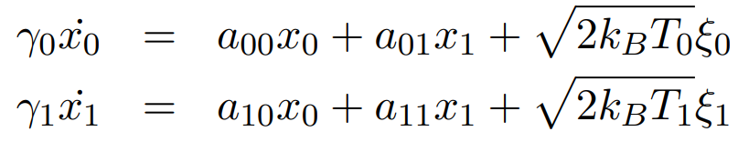
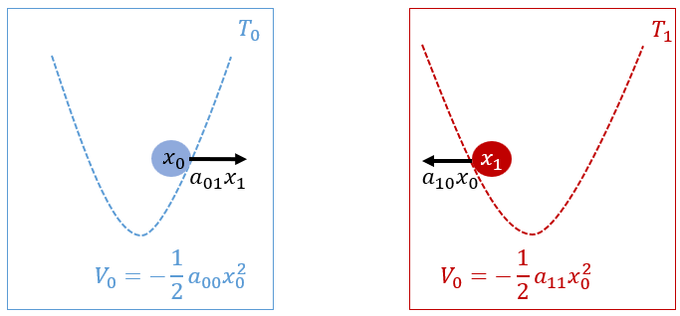
2-Dimensional Overdamped Langevin Equation
Theory
Case 3: Two systems with non-reciprocal coupling
(4)
$$a_{00}<0,a_{11}<0,a_{10}<0,a_{01}<0$$

Slide 12
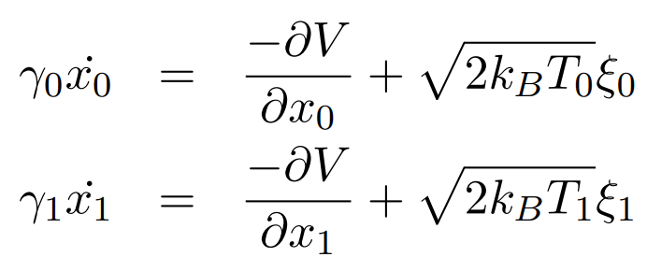
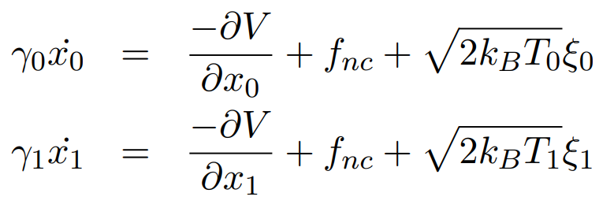
Reciprocal vs. Non-reciprocal Coupling
Theory
When $a_{10}= a_{01}$, the coupling is reciprocal
(4)
Equation (4) can be rewritten as:
(5)
When $a_{10}≠ a_{01}$, the coupling is non-reciprocal
Equation (4) becomes:
(6)
Non-reciprocal interactions appear as non-conservative forces in our equations of motion

Slide 13
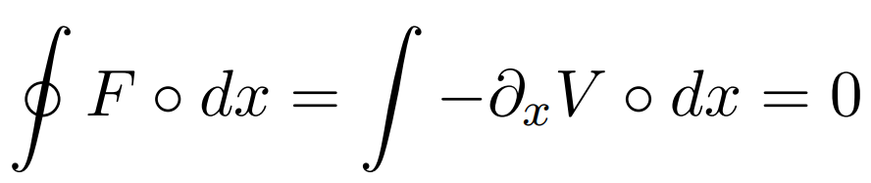
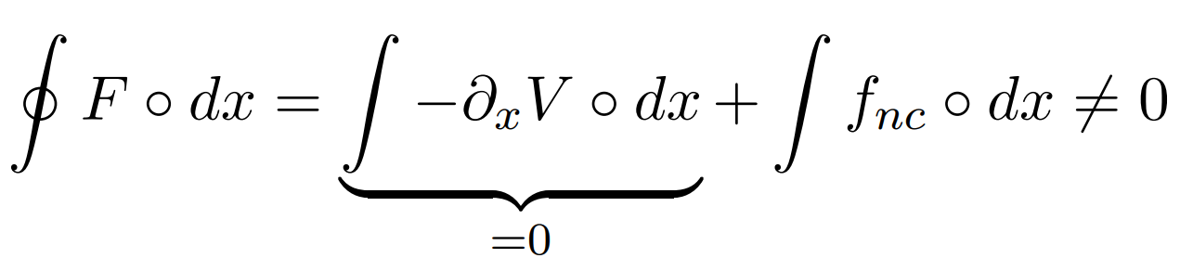
Non-conservative Force
Theory
Conservative force
(7)
Non-conservative force
(8)
System is at non-equilibrium → energy dissipation

Slide 14
Measures of Non-equilibrium
Theory
Heat rate
Violation of Fluctuation-Dissipation Theorem (FDT)

Slide 15
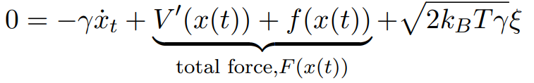
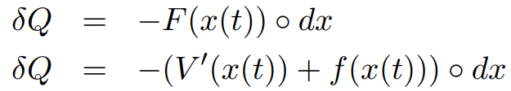
1. Heat rate
Theory: Measures of Non-equilibrium
Stochastic Heat^{[1]} – the energy exchanged between the system and the thermal environment
(9)
forces exerted by the thermal environment on the particle
The energy transfer from the environment to the particle:
(10)
cannot be measured experimentally in the laboratory
(11)
^{[1]}

Slide 16
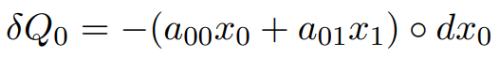
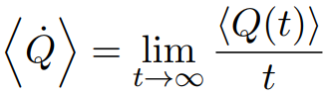
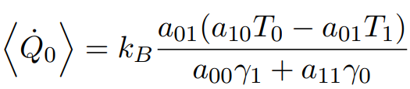
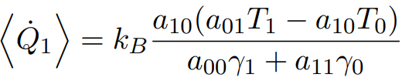
1. Heat rate
Theory: Measures of Non-equilibrium
(4)
Stochastic Heat dissipated for particle $x_{0}$ and $x_{1}$ in $[t, t+dt]$
(12)
Heat rate
Numerical simulation
(13)
Analytical solution^{[2]}
(14)
^{[2]}

Slide 17
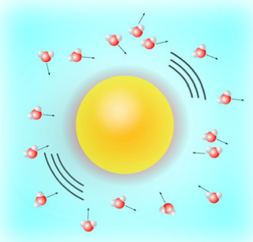
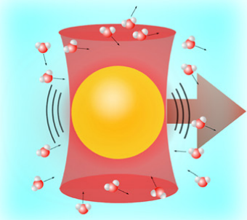
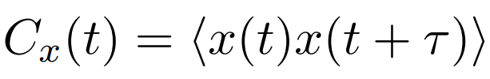
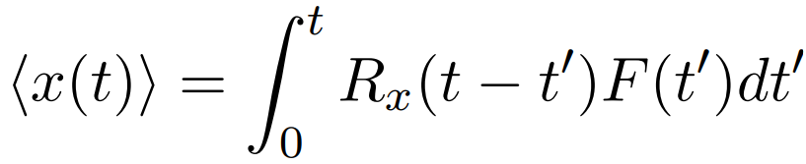
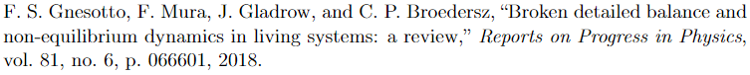
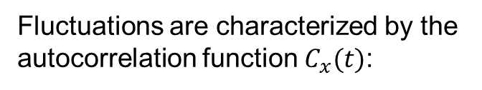
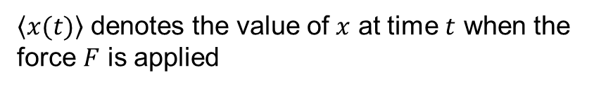

2. Violation of FDT
Theory: Measures of Non-equilibrium
Fluctuation-Dissipation Theorem^{[3]} (FDT) – relates the fluctuation of the system in the absence of external forces, and the response of a given system to an external force
Fluctuations are characterized by the autocorrelation function $C_{x}(t)$:
Response is characterized by a
response function $R_{x}(t)$:
(15)
(16)
Position autocorrelation function
$\left\langle x(t)\right\rangle$ denotes the value of $x$ at time $t$ when the force $F$ is applied
^{[3]}
Image from:

Slide 18
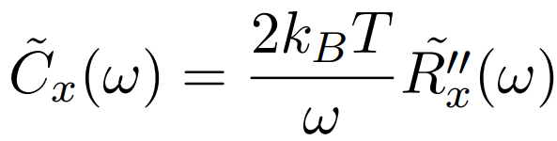
2. Violation of FDT
Theory: Measures of Non-equilibrium
(17)
Fluctuation-Dissipation Theorem (FDT)
holds for systems at thermal equilibrium
Image from:

Slide 19
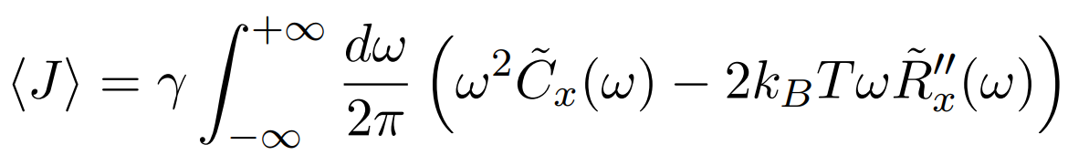

Measures of Non-equilibrium: Violation of FDT
Theory: Measures of Non-equilibrium
Energy dissipation from the violation of FDT (Harada-Sasa equality)^{[4]}
(18)
For an equilibrium system: $\left\langle J \right\rangle =0$
For a non-equilibrium system: $\left\langle J \right\rangle ≠0$
^{[4]}

Slide 20
Results

Slide 21
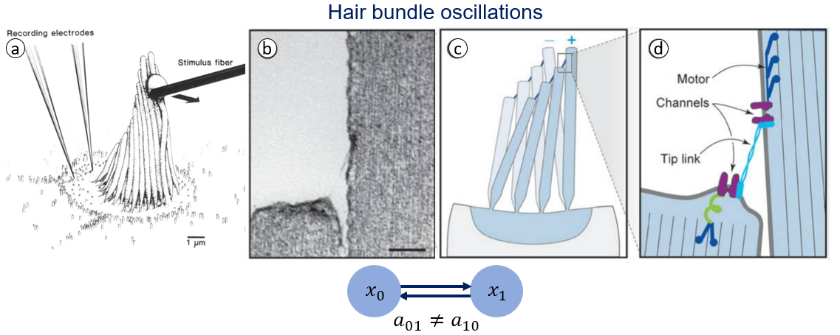
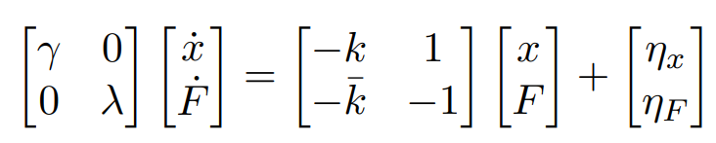
Biophysical Model 1: Hair bundle oscillations
Results
$X_{0}$ = position of the hair bundle $(x)$
$X_{1}$ = active force generated by the molecular motors inside the hair bundle $(F)$
[5]
Model from:
[6]
Image from [5-6]

Slide 22
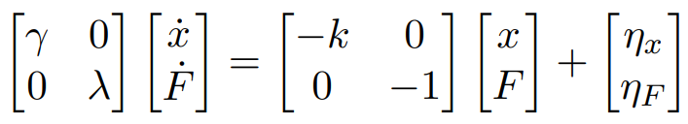
Biophysical Model 1: Hair bundle oscillations
Results
$X_{0}$ = position of the hair bundle $(x)$
$X_{1}$ = active force generated by the molecular motors inside the hair bundle $(F)$
Uncoupled case: Equilibrium limit
[5]
Model from:
[6]
Image from [5-6]
22

Slide 23
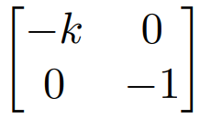
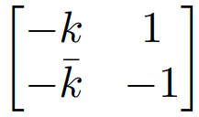
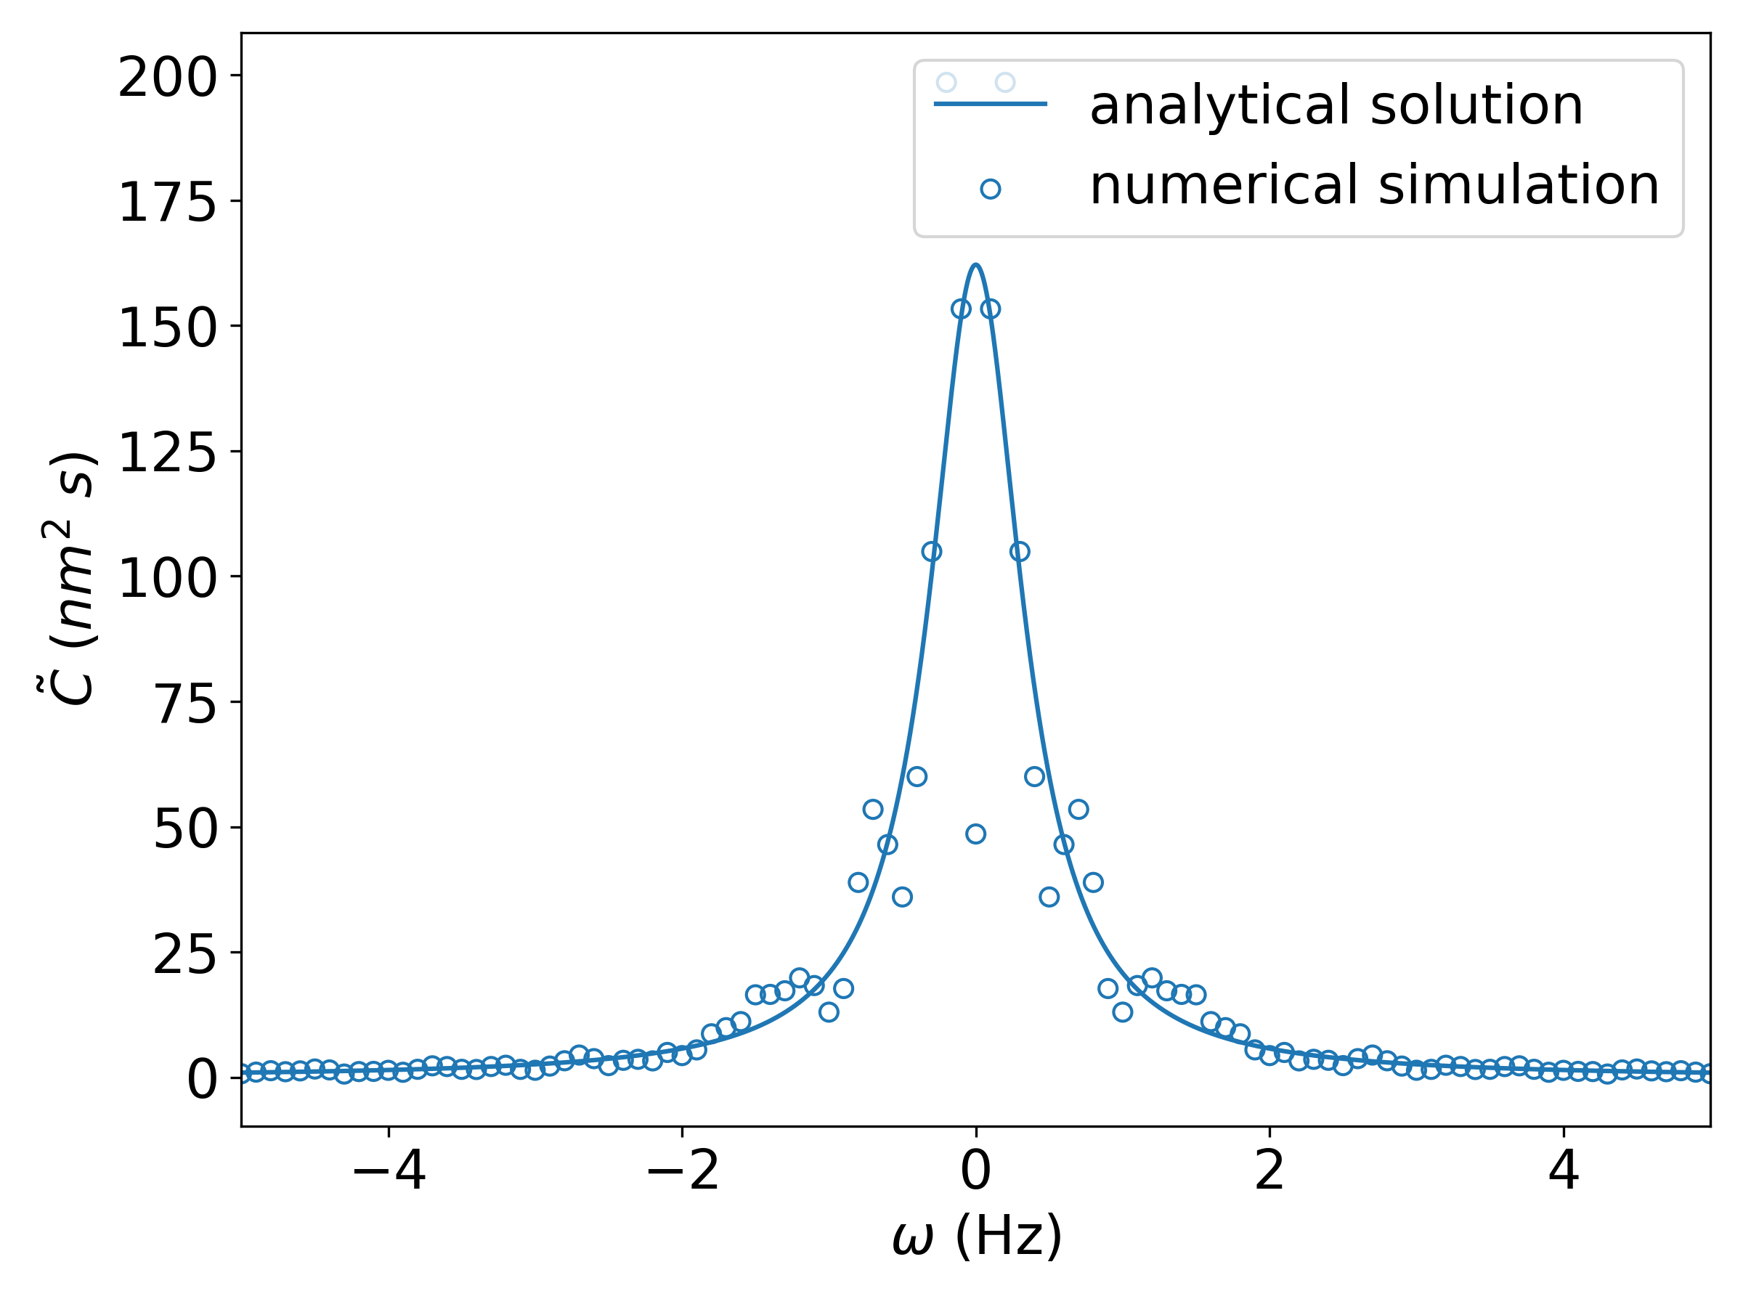
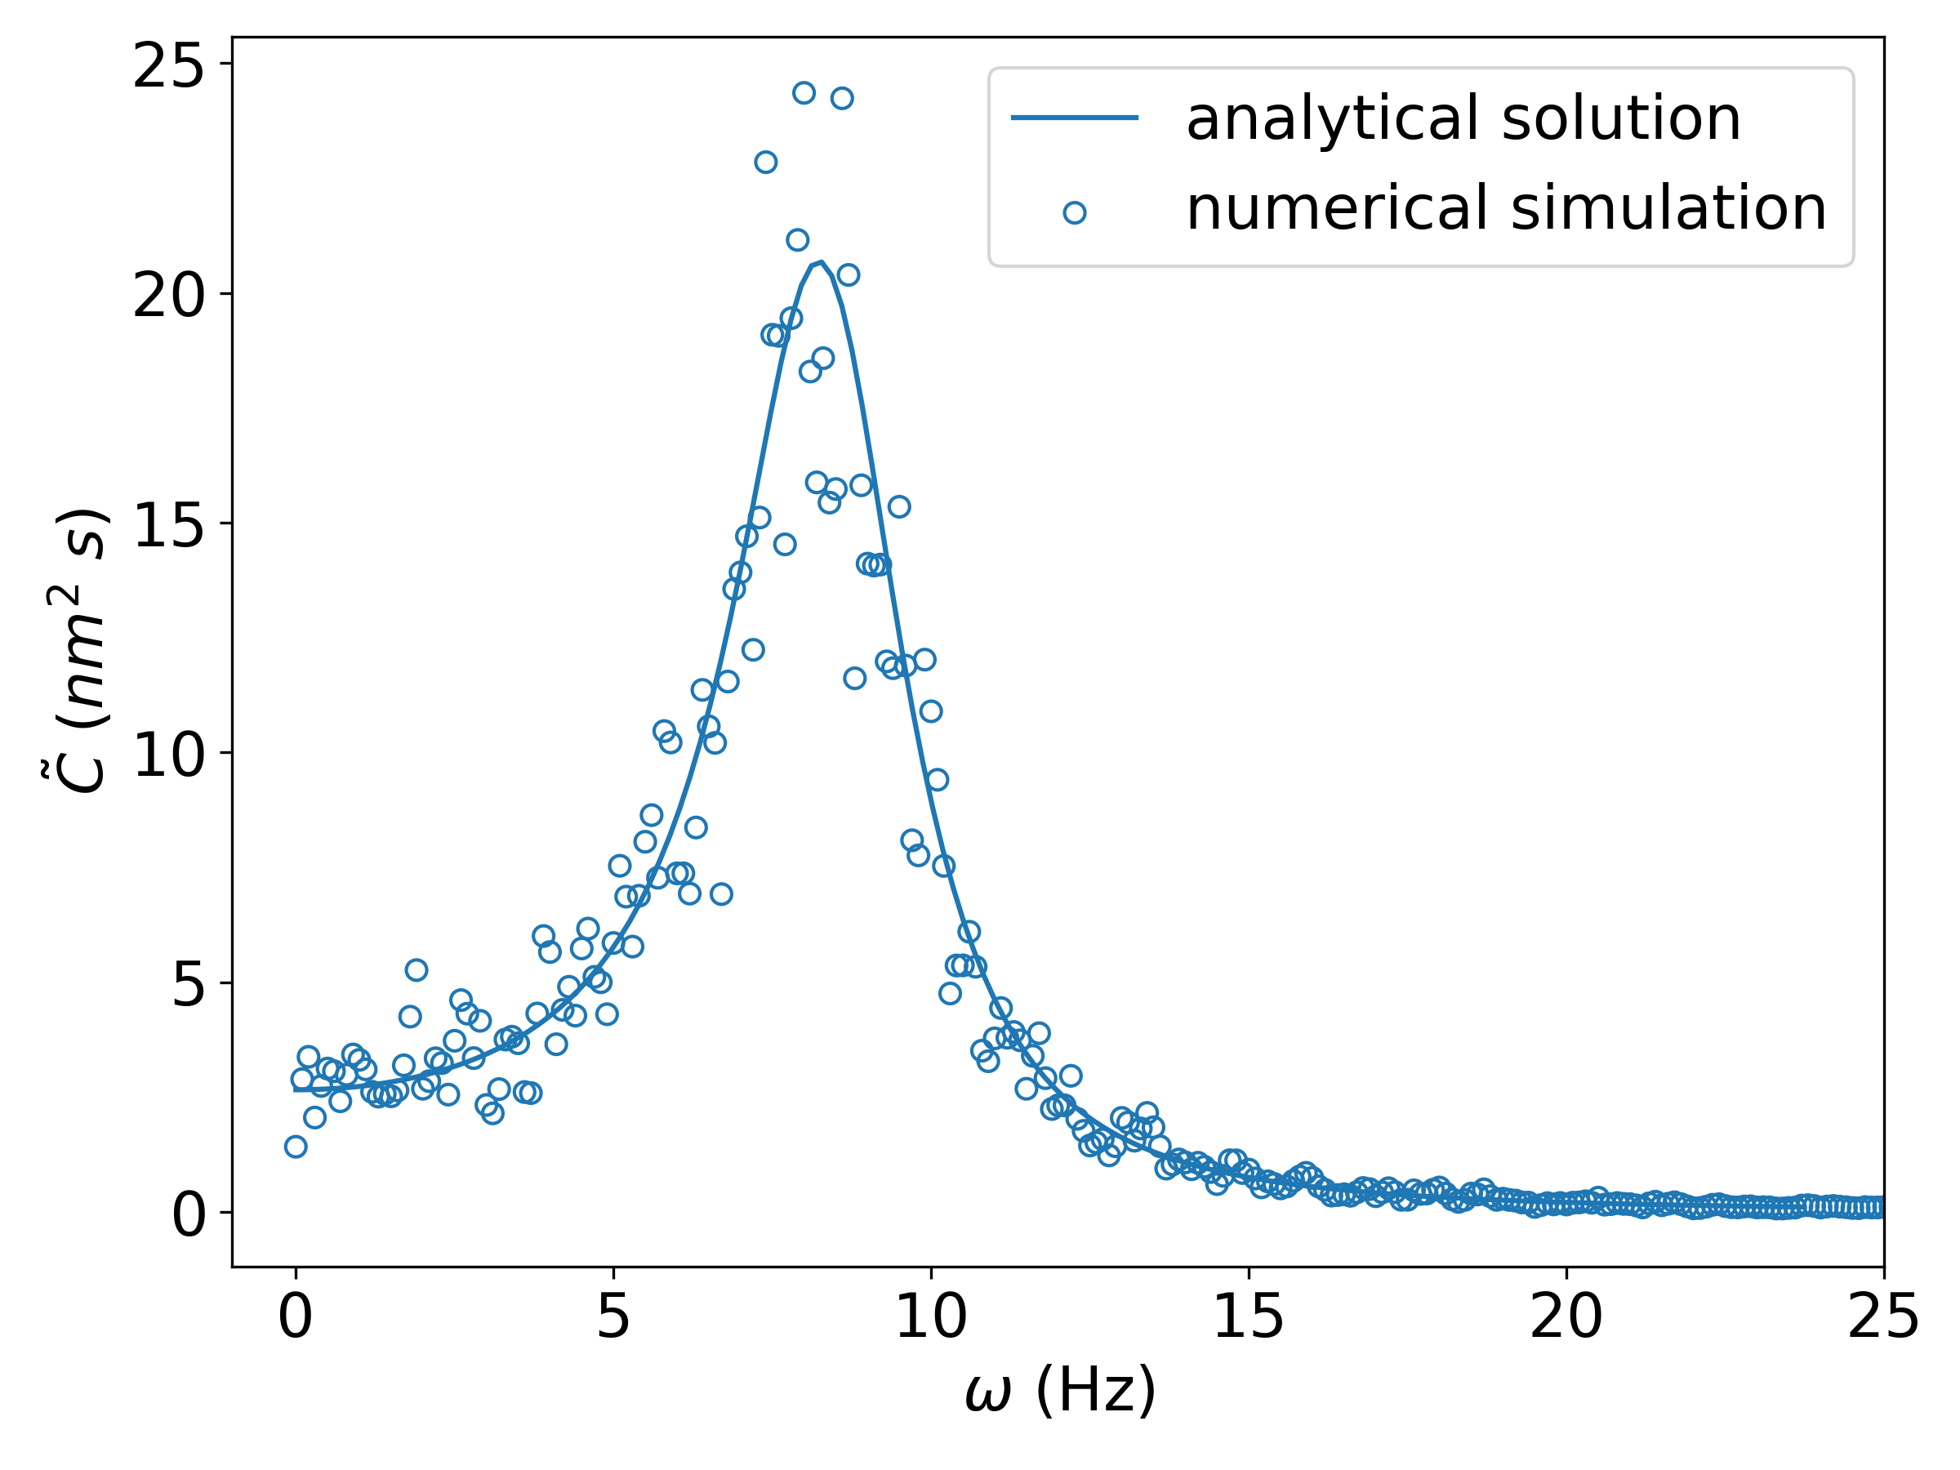
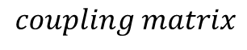
Autocorrelation function – Numerics vs. Analytical Solution
Results: Hair bundle oscillations
$$coupling matrix$$
Non-equilibrium case shows a peak at 8 Hz

Slide 24
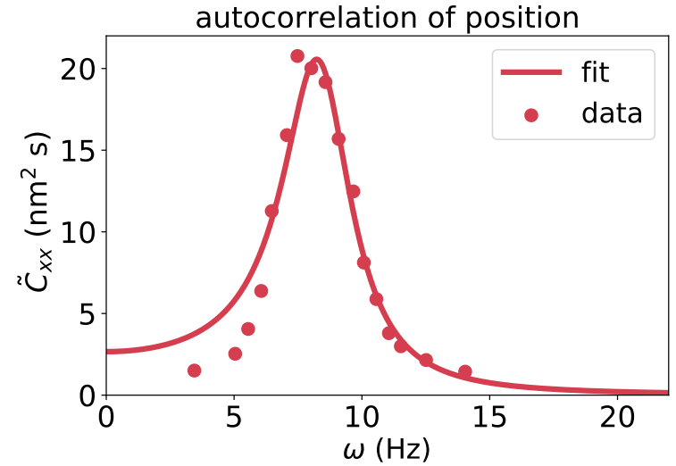
Autocorrelation function – Numerics vs. Analytical Solution
Results: Hair bundle oscillations
In agreement with results from Berger, et.al^{[7]}
Non-equilibrium case shows a peak at 8 Hz
^{[7]}

Slide 25
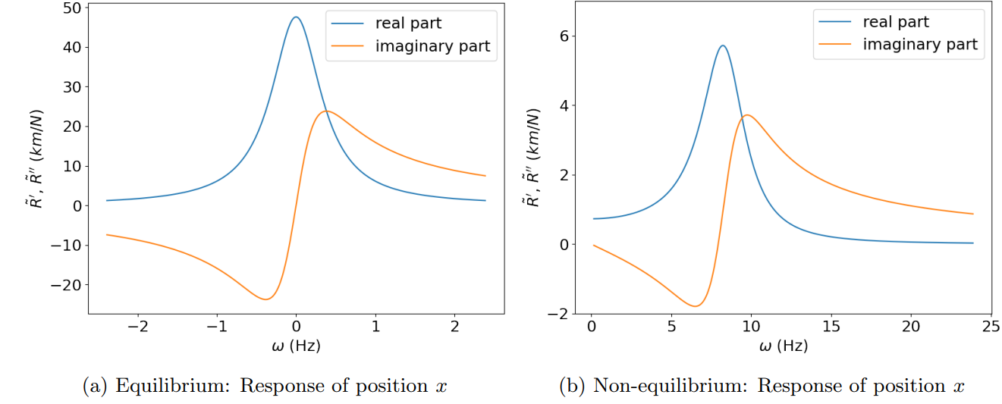
Response function – Analytical solution
Results: Hair bundle oscillations
Non-equilibrium: shows a peak at 8 Hz (real part), and a sign change at 8 Hz (imaginary part)

Slide 26
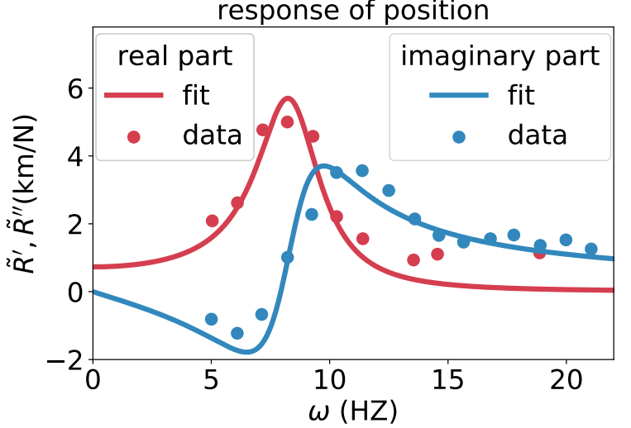
Response function – Analytical solution
Results: Hair bundle oscillations
In agreement with results from Berger, et.al^{[7]}
Non-equilibrium: shows a peak at 8 Hz (real part), and a sign change at 8 Hz (imaginary part)
^{[7]}

Slide 27
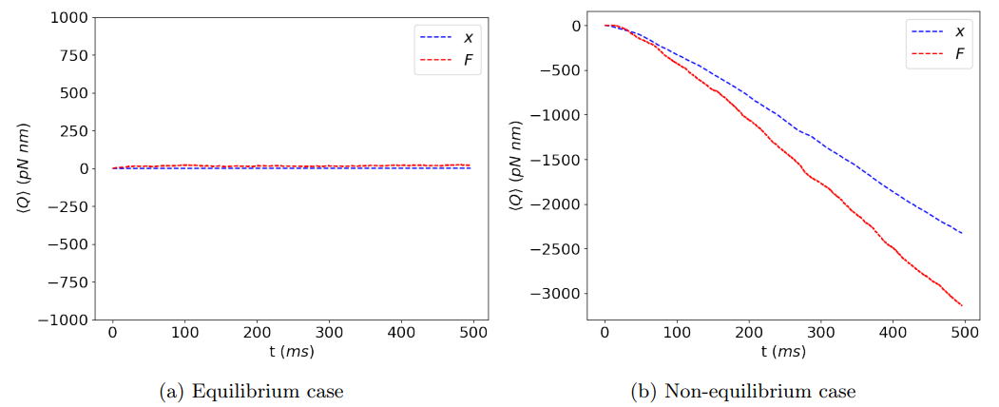
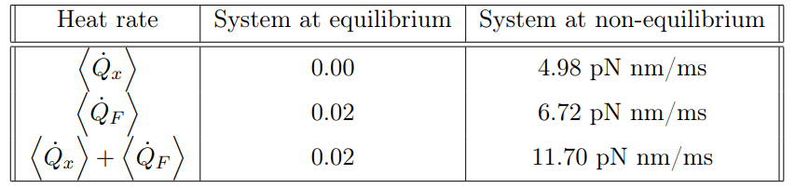
Heat rate (Numerics)
Results: Hair bundle oscillations
Average Cumulative Stochastic Heat
Non-zero heat rate for non-equilibrium system

Slide 28
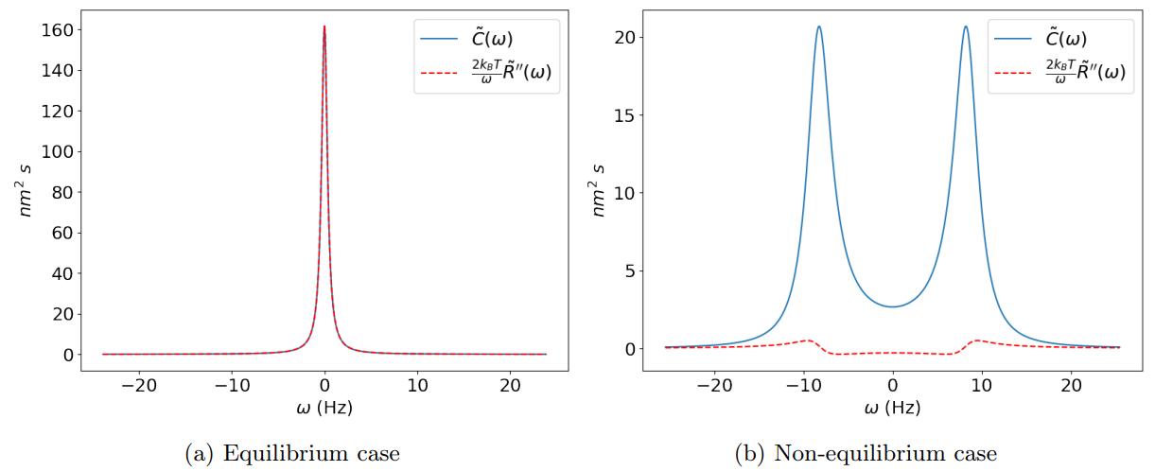
Energy dissipation from violation of FDT (Analytical solution)
Results: Hair bundle oscillations

Slide 29
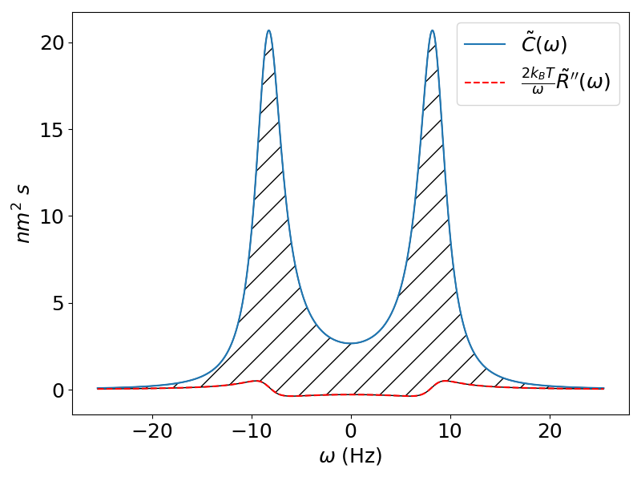
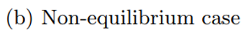
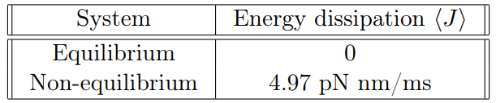
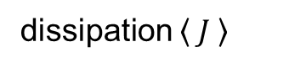
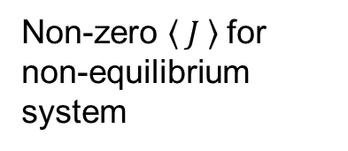
Energy dissipation from violation of FDT (Analytical solution)
Results: Hair bundle oscillations
dissipation $\left\langle J \right\rangle$
Non-zero $\left\langle J \right\rangle$for non-equilibrium system

Slide 30

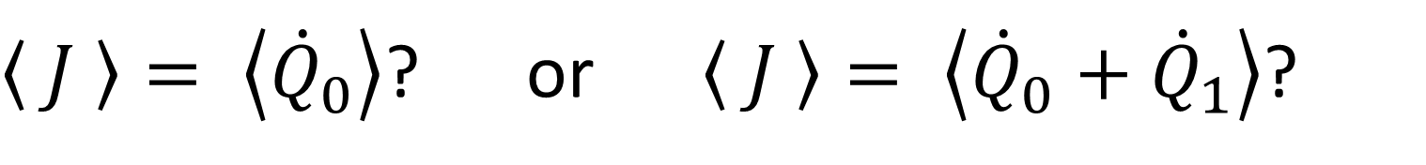
Relation between Heat Rate and Energy Dissipation Rate from the Violation of FDT
Results
For a 1-dimensional system:
$$\left\langle J \right\rangle = \left\langle \dot{Q}\right\rangle$$
How about for 2-dimensional systems exhibiting non-reciprocal interactions?
$\left\langle J \right\rangle = \left\langle {\dot{Q}}_{0}\right\rangle$? or $\left\langle J \right\rangle = \left\langle {\dot{Q}}_{0}+{\dot{Q}}_{1}\right\rangle$?

Slide 31



Biophysical Model 2: Cellular sensor model
Results
$X_{0}$ = receptor sensing the signal $(r)$
$X_{1}$ = signal: external ligand concentration (x)
Unidirectional coupling

Slide 32




Heat Rate and Energy Dissipation from violation of FDT
Preliminary Results: Cellular Sensor Model
dissipation $\left\langle J \right\rangle$
Since $r$ is unidirectionally coupled to $x$, then $r$ is at non-equilibrium characterized with a non-zero heat rate and energy dissipation

Slide 33




Different Degrees of Reciprocity: Isothermal conditions
Results: Heat rate for $x_{0}$ and Energy dissipation from violation of FDT
(4)
Setting $a_{10}=−0.5$, we vary $a_{01}$ from $−0.5$ to $0$. Isothermal condition ($T_{0}=T_{1}$)
system has reciprocal coupling
$x_{0}$is uncoupled to $x_{1}$
system has non-reciprocal coupling

Slide 34

Different Degrees of Reciprocity: Isothermal conditions
Results: Heat rate for $x_{0}$ and Energy dissipation from violation of FDT
Setting $a_{10}=−0.5$, we vary $a_{01}$ from $−0.5$ to $0$. Isothermal condition ($T_{0}=T_{1}$)
Then $\left\langle J \right\rangle = \left\langle {\dot{Q}}_{0}\right\rangle$

Slide 35




Different Degrees of Reciprocity: Non-isothermal conditions
Results: Heat rate for $x_{0}$ and Energy dissipation from violation of FDT
Setting $a_{10}=−0.5$and $T_{0}=300K$, we vary $a_{01}$ from $−0.5$ to $0$ and $T_{1}$ from $200K$ to $400K$
Can thermal equilibrium exist when there is non-reciprocal coupling?
Loos, et.al^{[8]} showed that there is a special case, where a temperature gradient is introduced in the system:
Plot is symmetric with respect to the point of $a_{01}$ at
(19)
(20)
^{[8]}

Slide 36






Conclusions
The value of $\left\langle J \right\rangle =\left\langle {\dot{Q}}_{o}\right\rangle$
Hair bundle oscillations show that the system is out of equilibrium. The frequency that contributes the highest to the energy dissipation is at 8 Hz, the bundle’s frequency of spontaneous oscillation.
Cellular sensor model shows that the system is out of equilibrium. The frequency that contributes the highest to the energy dissipation is at 0 Hz.
Hair bundle model
Cellular sensor model
Violation function:
(21)

Slide 37
Thank you!

Slide 38


Autocorrelation and Response function
Preliminary Results: Cellular Sensor Model

Slide 39


Autocorrelation function – Numerics vs. Analytical Solution
Results: Hair bundle oscillations
$$coupling matrix$$
Equilibrium: follows a Lorentzian function
Non-equilibrium: shows a peak at 8 Hz

Slide 40


Different Degrees of Reciprocity: Isothermal conditions
Results: Heat rate for $x_{1}$
Setting $a_{10}=−0.5$, we vary $a_{01}$ from $−0.5$ to $0$. Isothermal condition ($T_{0}=T_{1}$)
system has reciprocal coupling
$x_{1}$is unidirectionally coupled to $x_{0}$
system has non-reciprocal coupling

